Slide 1

Customer management application Made by: Jankovics Dávid, Nagy Szabolcs

Slide 2

Requirements:
•Design
•The usage of figma and github .
• task given by chatgpt
To solve it with the help of chatgpt
•Must be finished before: 2024/04/03.

Slide 3
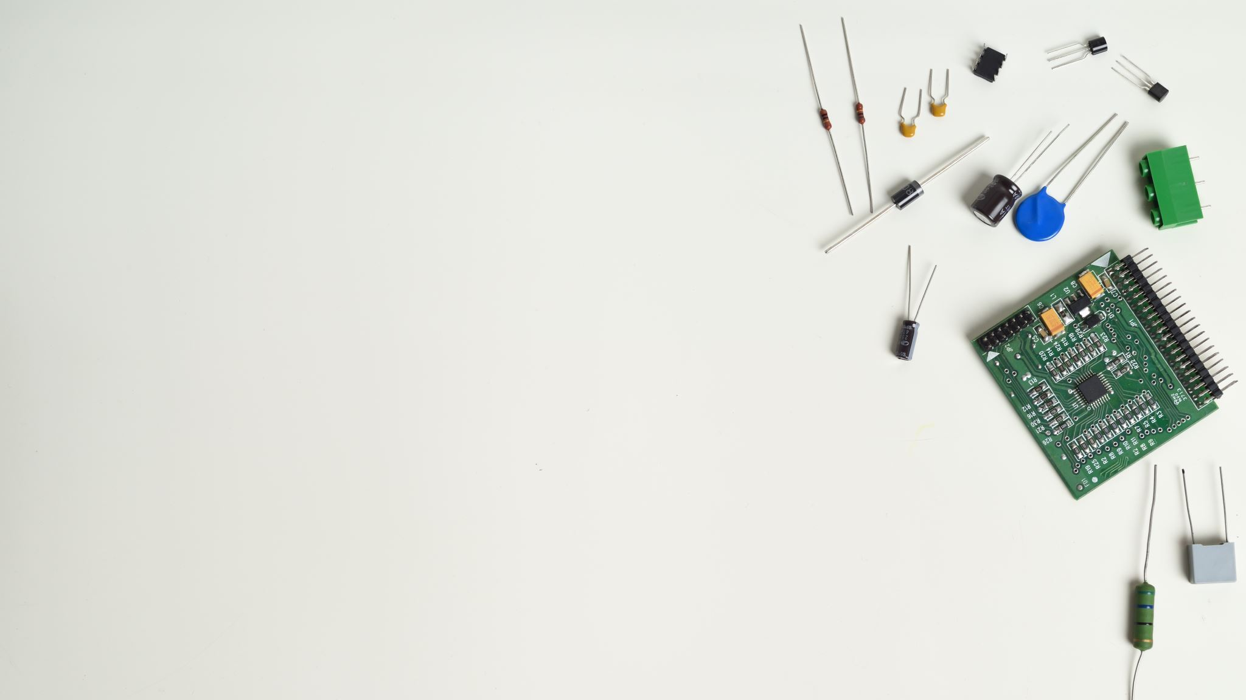
Staff and their jobs
Nagy Szabolcs: Program Writer(partly), ppt presenter
Jankovics Dávid: Project Manager, Design Creator, Powerpoint maker, Wireframe designer and Program Writer(partly), ppt presenter

Slide 4
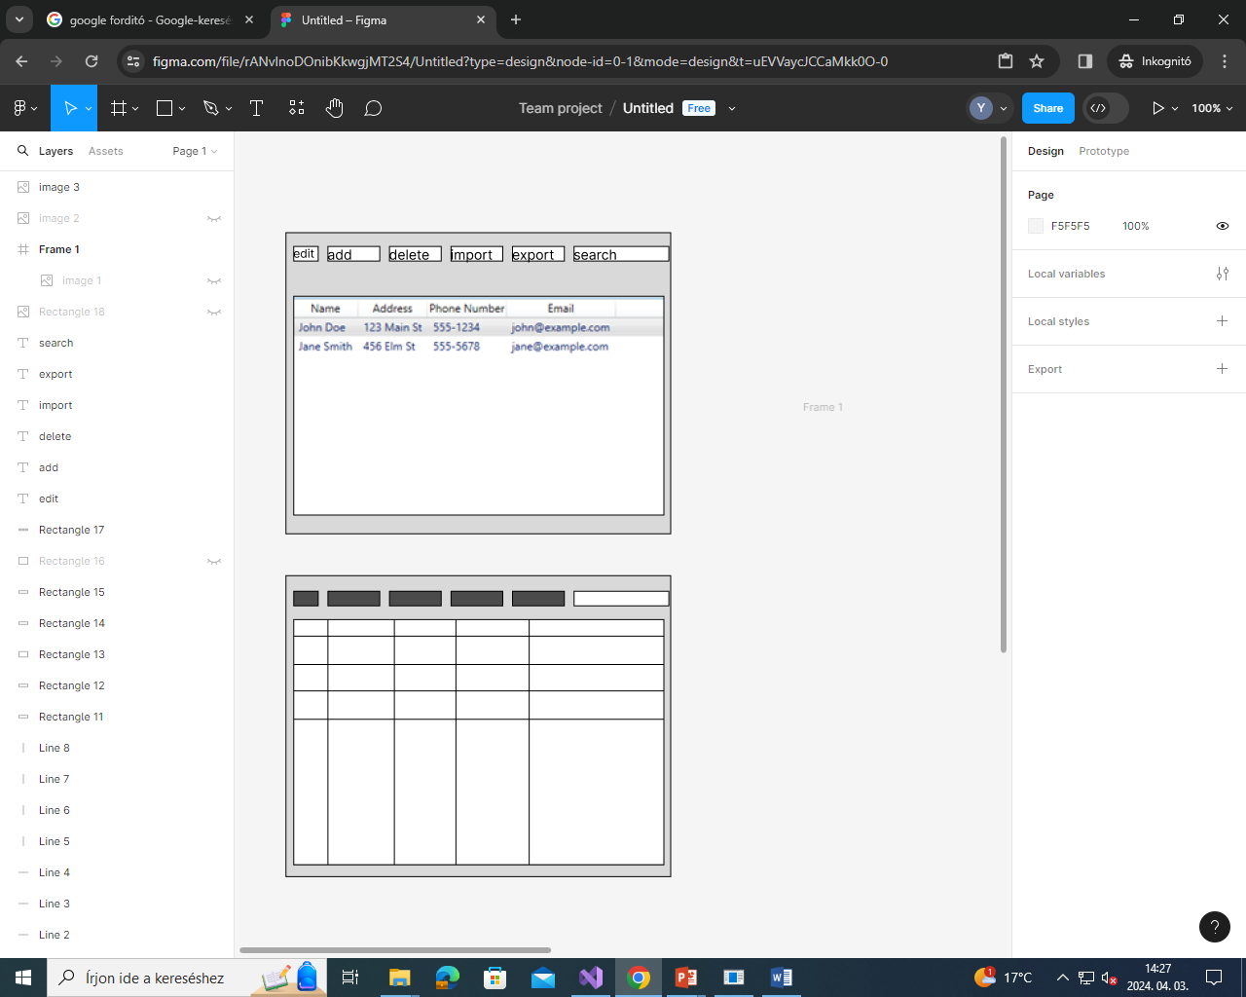
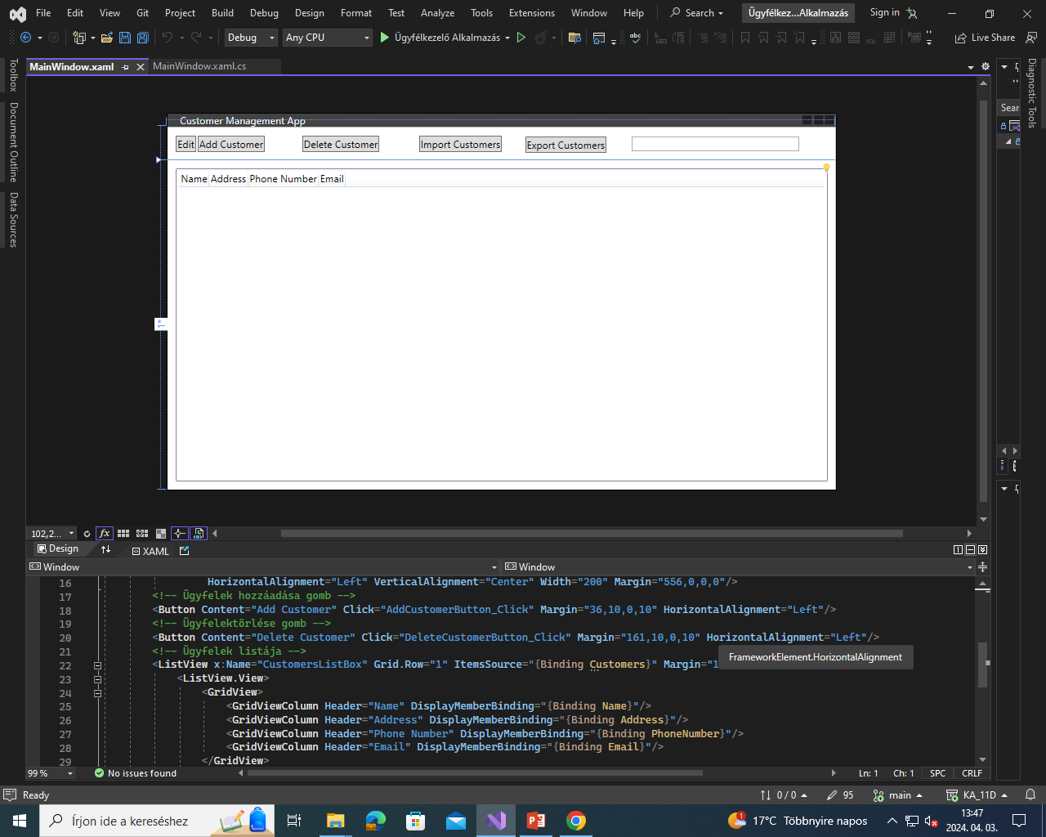
Apps we used
Figma: To create the basics for the design and for the wireframe
Visual studio
Communications: voice

Slide 5
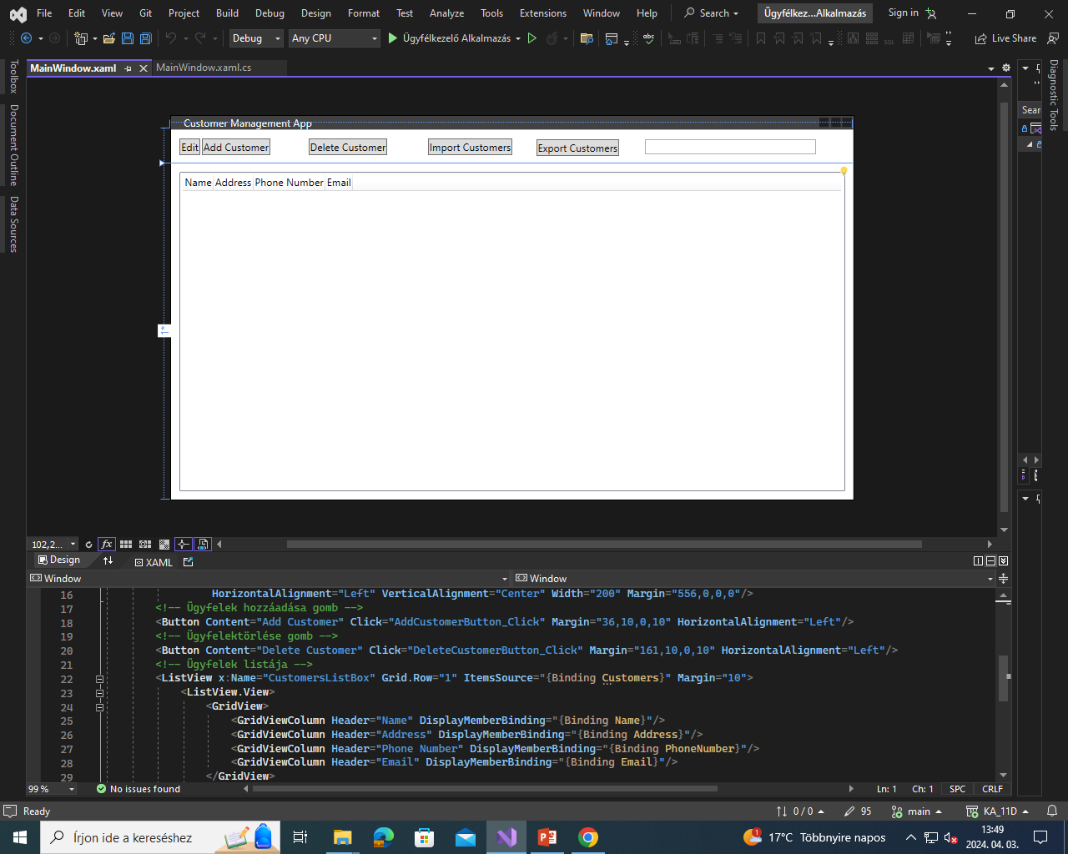
Code we used
We have used C# as that is what chatgpt said to use

Slide 6
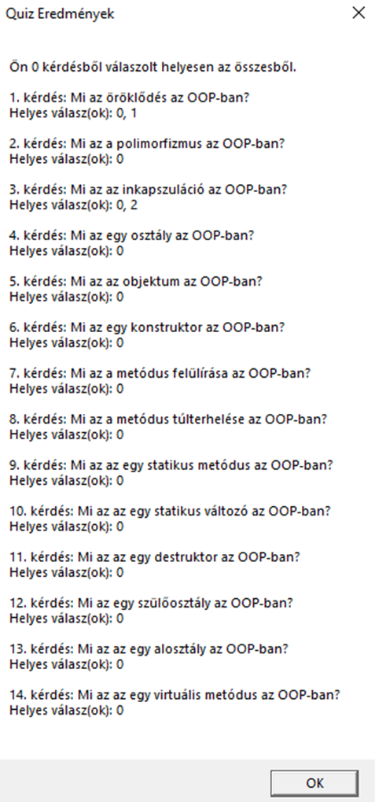
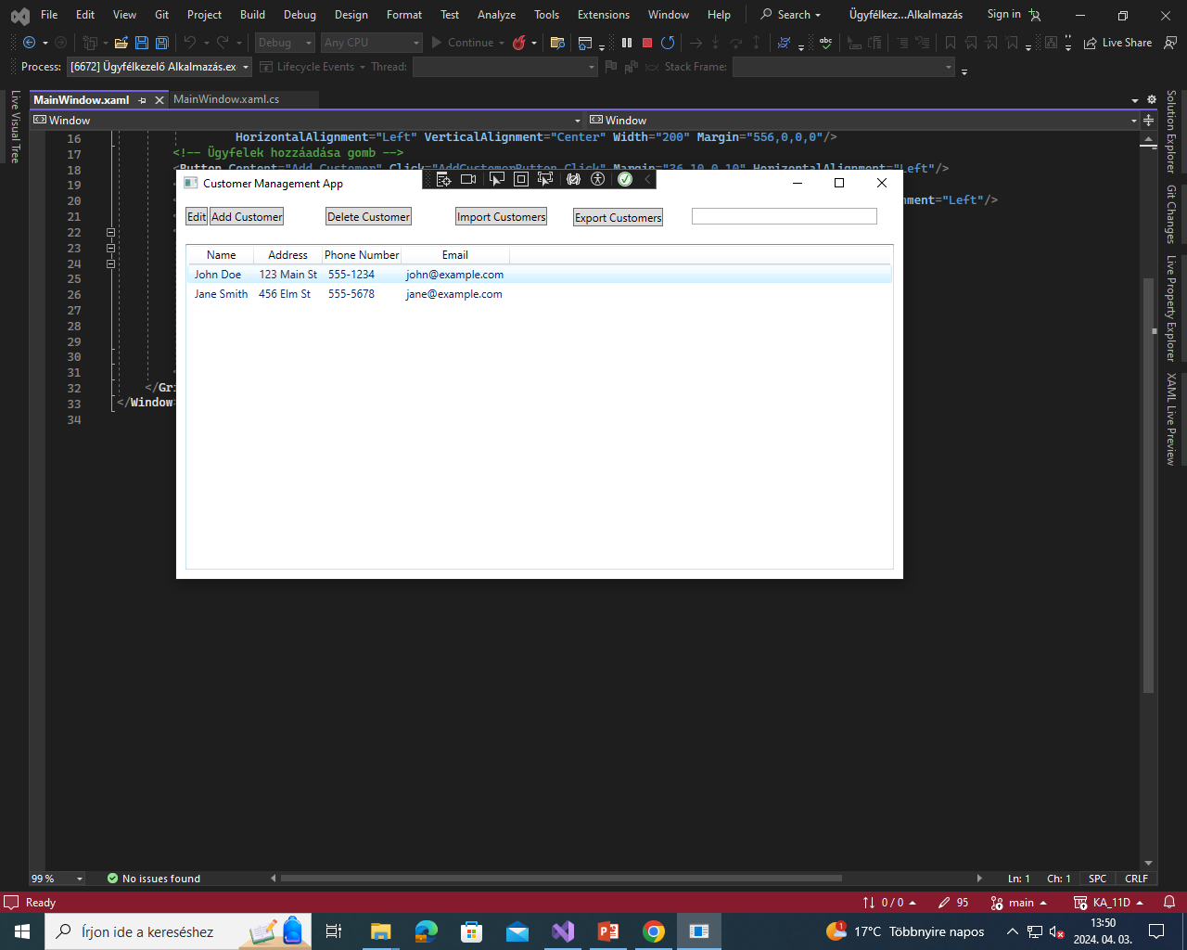
Features
Adding, deleting customers
Importing and exporting the data
Edit already existing customers data

Slide 7


The full program

Slide 8

Thank you for your attention!

